Slide 1
Likitha.V [153042] Team-2 Training Room 4 Capgemini MIPL Chennai

Slide 2
CAPSTORE APPLICATION

Slide 3
Modules Assigned
Change Password

Slide 4

Change Password:
Users have the option to change the password from their profile.
Customer will be navigated to the page where he has to enter current and the new password which should not be same.
Password is checked with the validation constraints.
If it satisfies the constraints, then password is encrypted and stored in the database.
Tables to be interacted are customer and merchant.
Click to insert section title
Notes:
O Logo de espadas deve ter mais espaço das pontas abaixo. Sugerir outros tipos de imagens/ telefone, fones.

Slide 5

Tables used
Customer
Merchant
Customer Id
Name
Phone Number
Email Id
DOB
Password
Is Active
Last Login
Merchant Id
Name
Company Name
Email Id
Password
Status
Phone Number
Is Active
Is Certified
Notes:
Otimo.
Mas eles acham que talvez a forma verde va conflitar se eles mudarem o logo espada para cima do lado direito.

Slide 6
Tables :
Customer Table
Column Name | Data type | Constraint | Description
customerId | int | Primary key Auto Generated | Used for unique identification
customerName | varchar | NotNull
phoneNumber | int | NotNull
emailId | varchar | unique | Will be Used for user Login
Dob | Date | NotNull
Password | Varchar | NotNull | Authentication purposes
Address | varchar | Foreign Key
Status | Varchar | NotNull | To let know if user is active or not
Notes:
Fixar a posicao do titulo – sempre do lado esquerdo.
Sempre que tiver muito texto o coluna deve sempre ser “ narrowed” , se nao fica dificil de ler. Colocar paragrafos no texto.
Linha vertical deve ser mais fina e as pontas NUNCA devem ser arredondadas.

Slide 7
Merchant Table
Column Name | Data type | Constraint | Description
merchantId | int | Primary key Auto Generated | Used for unique identification
merchantName | varchar | NotNull
phoneNumber | int | NotNull
emailId | varchar | unique | Will be Used for merchant Login
companyName | varchar | NotNull
Password | Varchar | NotNull | Authentication purposes
Address | varchar | Foreign Key
Status | Varchar | NotNull | To let know if user is active or not
isCertified | Boolean | NotNull | Is the Merchant CapStore Certified or Not
isValidated | Boolean | NotNull | Is the Merchant CapStore validated by admin or not
Notes:
Fixar a posicao do titulo – sempre do lado esquerdo.
Sempre que tiver muito texto o coluna deve sempre ser “ narrowed” , se nao fica dificil de ler. Colocar paragrafos no texto.
Linha vertical deve ser mais fina e as pontas NUNCA devem ser arredondadas.

Slide 8
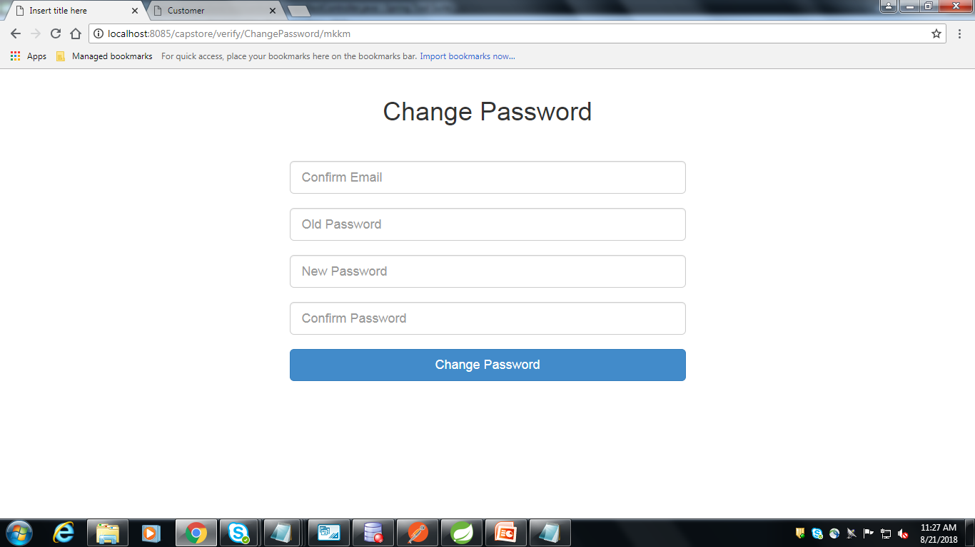
Change Password
When user enters the change password page, user’s email will be verified. When he enters the old password , then it will be checked with the encrypted password in the database.
1
When user enters the new password, it should be encrypted and should be compared with confirm new password , if they match then it should be updated in database.
2
3
After checking all constraints, it will display password changed successfully.
www.referencia.com
© 2017 Capgemini. All rights reserved.
8
Notes:
Este slide eles acham que esta muito apertado.
Mudar o estilo do texto do lado esquerdo para diferencia-lo do texto do lado direito. Menos texto e mais impactante “short introduction”. Coloccar este texto do lado esquerdo da mesma cor da forma e o fundo do dlide claro.

Slide 9
THANK YOU

